Slide 2

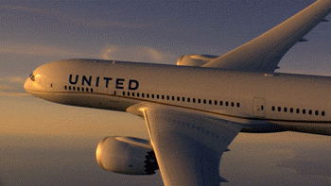
Social Sentiment And
Stock Analysis
Aurora, Martin, Prateek
Notes:
Hi every one, today we will be talking about social sentiment and stock analysis. This is like a litmus test, an attempt to correlate the stock price with the sentiment mean compound score

Slide 3





Agenda
Data Exploration and
Approach
Conclusion and
Results
Data collection process
When, where and how ?
Closing thoughts
Scope and
Problem Statement
Data Analysis and
Methodology
Q&A’s
Overview of our plan
What we are trying to do?
Summary and statistics of the collected airline data
Additional information for further reading
Notes:
We divided our work into four small milestones to get the results.
Will be covering the scope & PS, Approach & analysis, results

Slide 4

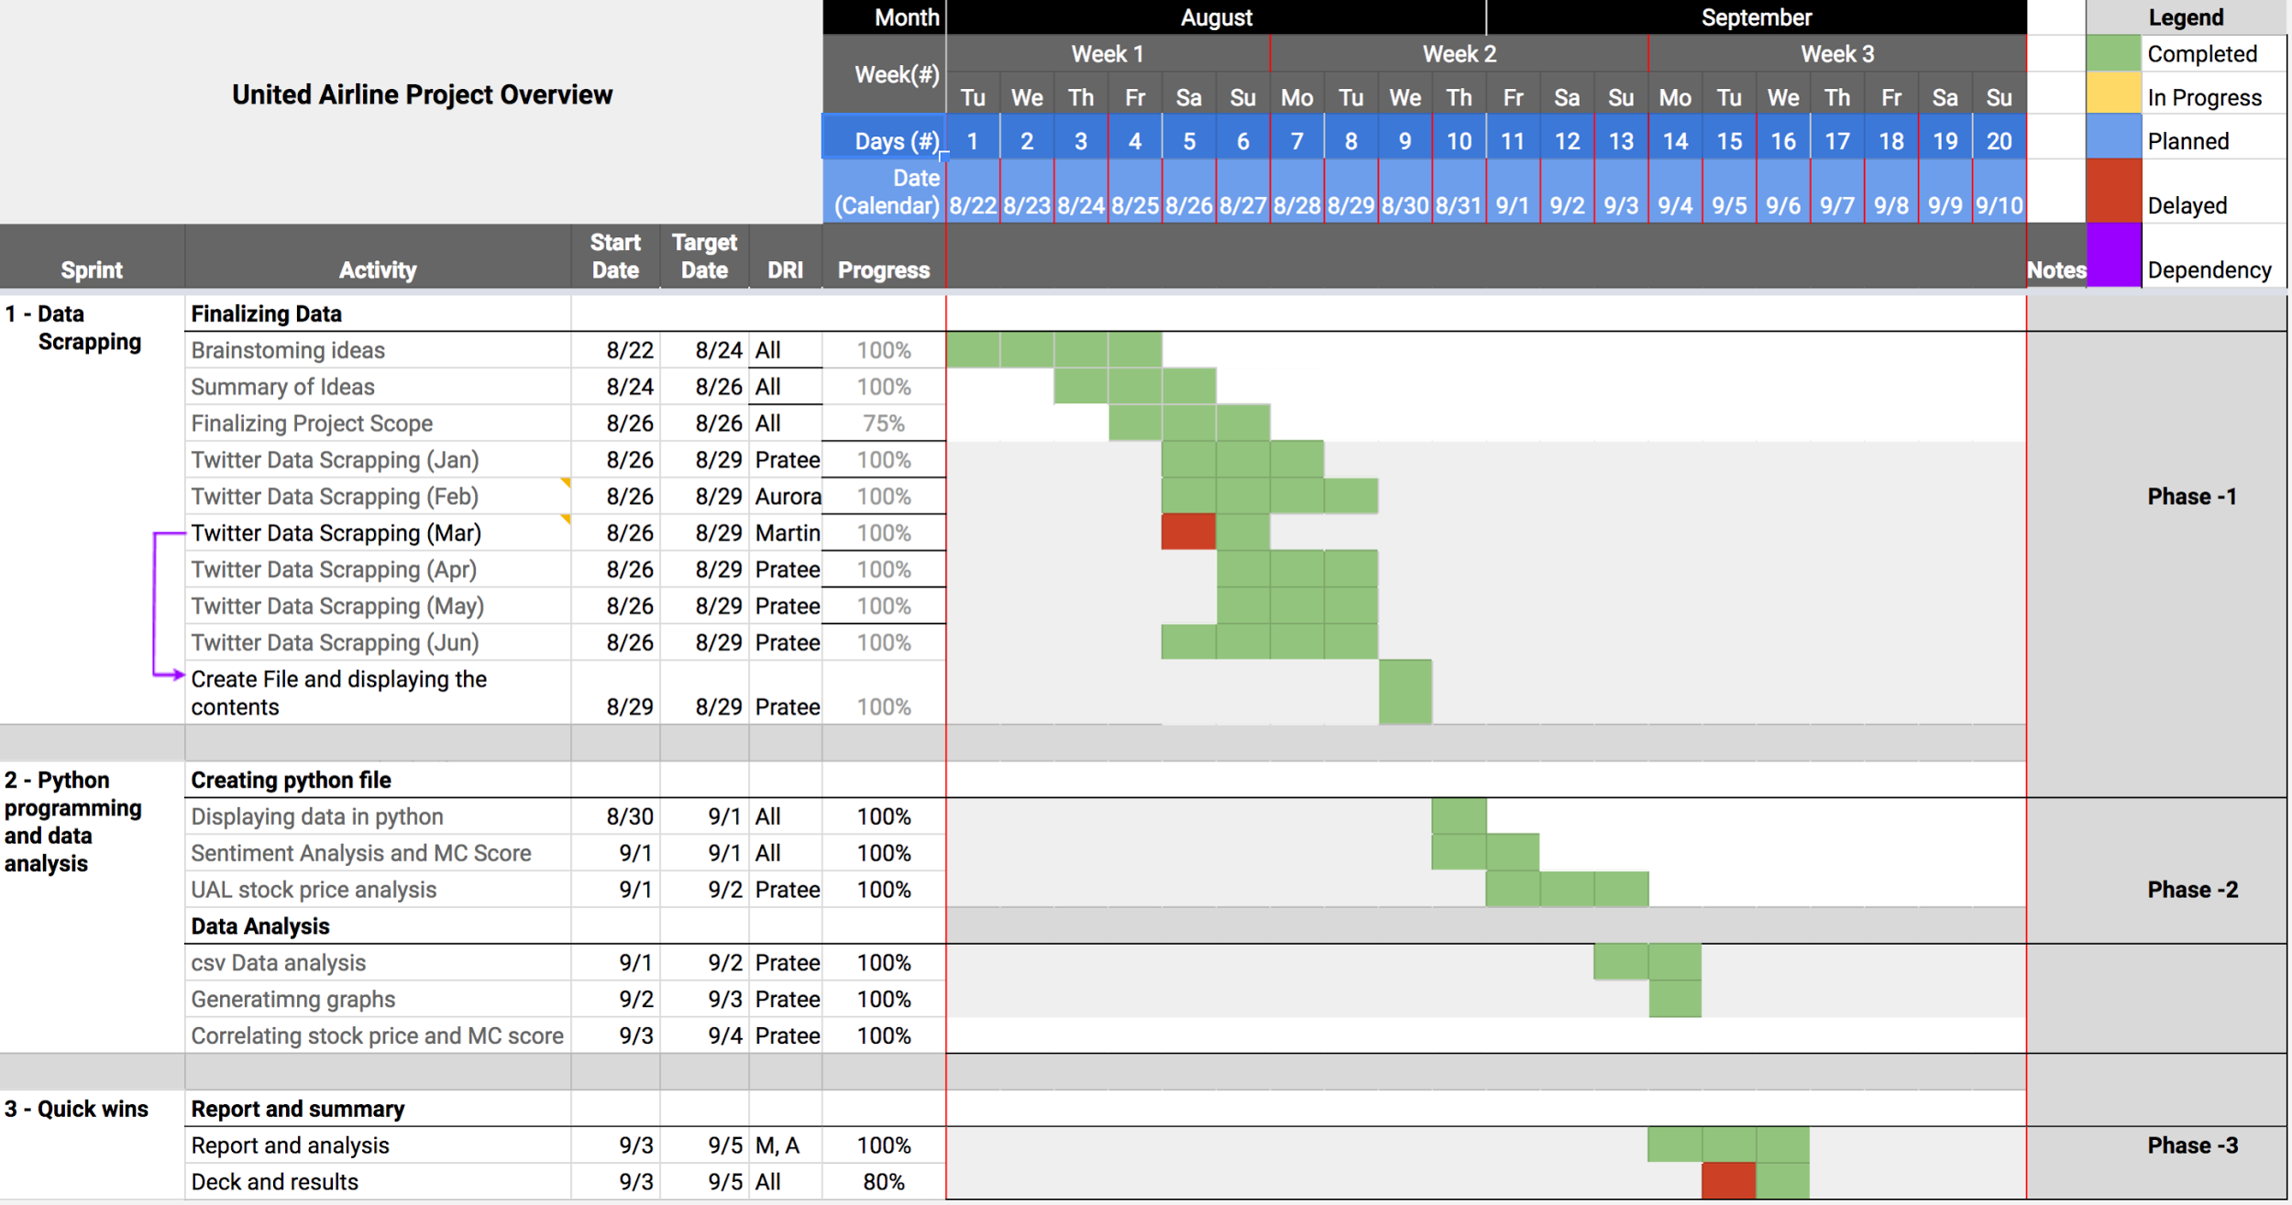
Introduction and Project Plan
United Airlines, Inc. provides air transportation services in North America, the Asia-Pacific, Europe, the Middle East, and Latin America.
As of December 31, 2016, the company operated 1,231 aircraft.
Sells fuel; and offers catering, ground handling, and maintenance services for third parties.
Followed Agile approach by breaking up milestones into several stages and involved constant collaboration among team members to achieve quick wins
Able to get results in one single ‘iteration’ cycle
Notes:
* Source : Bloomberg Financials
* For our analysis, we considered the stock price of united airlines. For those who are unaware, United Transports people and cargo through its mainline and regional operations.
* Agile approach - Agile approaches help teams respond to unpredictability through incremental, iterative work cadences and empirical feedback.

Slide 5

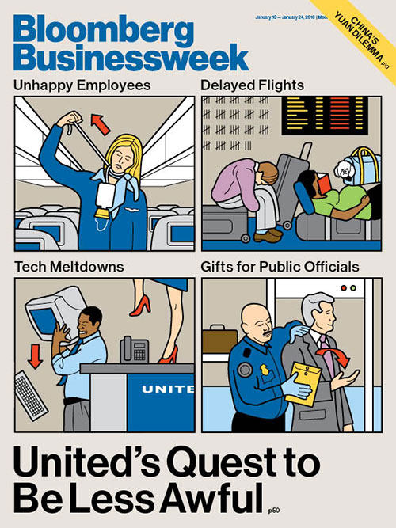
Problem Statement
The project aims to use rule-based classification to predict content sentiment of Twitter feeds that mentioned United Airlines (#united, @united)
Collect tweets for a duration of six months using API/html scrapping; python packages(beautifulsoup)
Utilize VADER lexicon to perform sentiment analysis and obtain mean compound score for each day
Obtain UAL daily stock statistics; using pandas library to extract and create file(data_reader)
Compare the relation of mean compound score and stock price fluctuations
Relate any major event to sentiment and price movement
Observe if there is the effect on United Airlines stock price based on twitter sentiment
Notes:
Image source: Bloomberg Businessweek - https://www.bloomberg.com/features/2016-united-airlines-struggles/

Slide 6
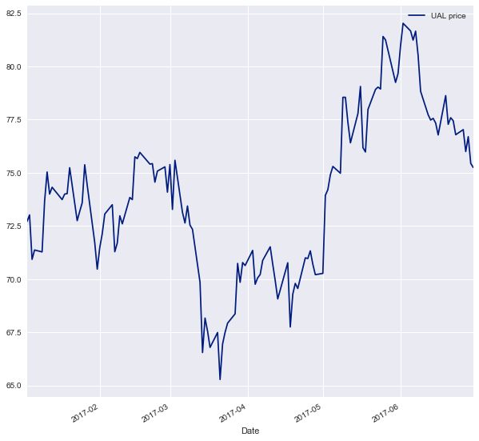

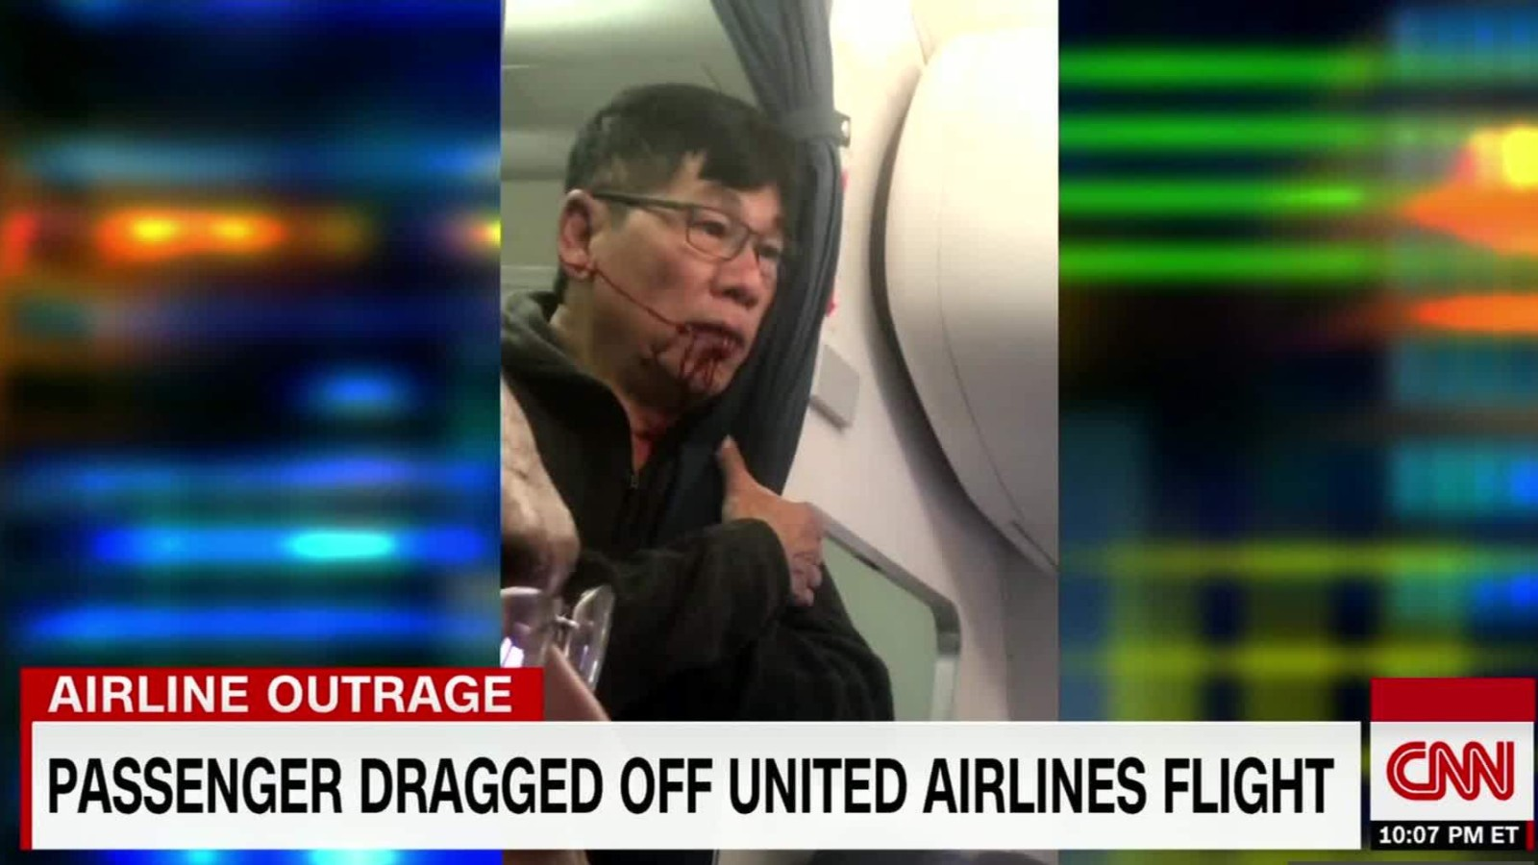
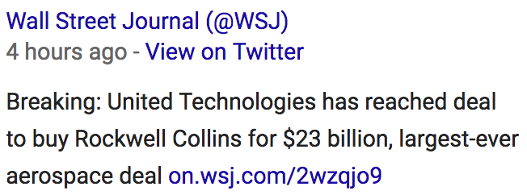
United Airlines Stock Price
The upward trend indicates that the mean and variance are changing with respect to time.
The graph shows what might be seen as a break or a pulse in mid-April 2017.
The timing of this break corresponds to a time when a United Airline staff dragged a customer off the plane; this event according to FactSet, wiped off $255m from the company’s market capitalization.
Stock bounced back shortly on a bullish run, and even tested a new high following the break.
This shows that United airline customers might appear to loath the company at the time, but the effect on investor confidence was not sustained.
United Flight 3411 incident
Notes:
The time series for the closing prices were sourced directly with a line of code from the yahoo finance web page.
https://pandas-datareader.readthedocs.io/en/latest/
Overall upward trend with moderate fluctuations
However, the stock bounced back shortly on a bullish run, and even tested a new high following the break. This shows that United airline customers might appear to loath the company at the time, but the effect on investor confidence was not sustained / this shows that united airline customers might loath the company but their investors like them.

Slide 7
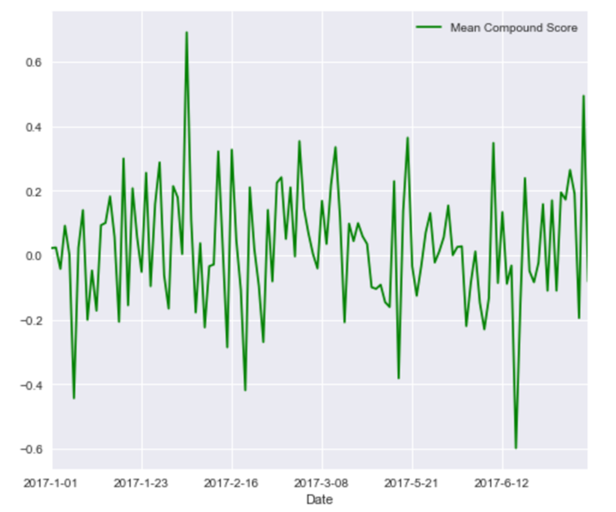
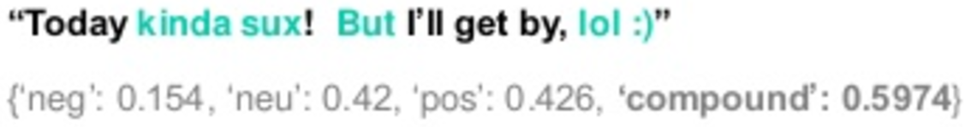
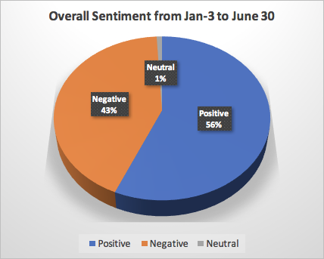
These sentiments were measured using Vader Sentiment Analysis. See sample,
With hashtag “#united and with a mention to @united(United Airlines twitter handle)
Then used The Beautifulsoup to scrape and extract the tweets
United Airline Twitter Sentiment
positive sentiment: compound score >= 0.5
neutral sentiment: (compound score > -0.5) and (compound score < 0.5)
negative sentiment: compound score <= -0.5
Notes:
It is also useful for researchers who would like to set standardized thresholds for classifying sentences as either positive, neutral, or negative. Typical threshold values (used in the literature cited on this page) are:
positive sentiment: compound score >= 0.5
neutral sentiment: (compound score > -0.5) and (compound score < 0.5)
negative sentiment: compound score <= -0.5

Slide 8
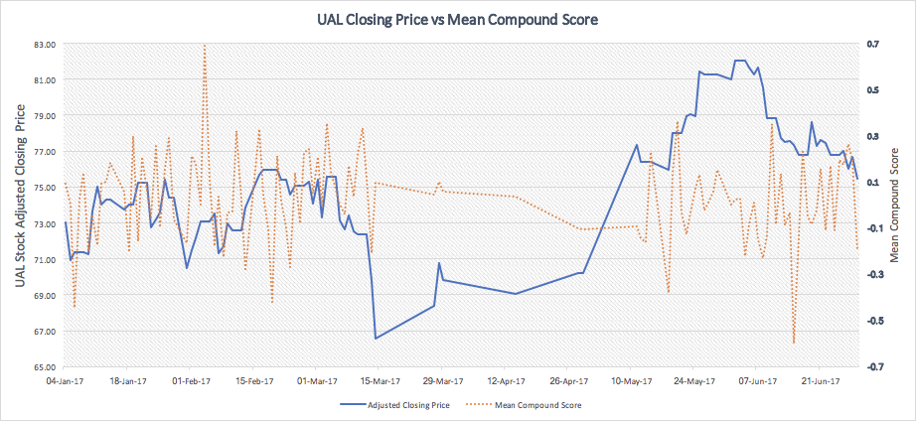


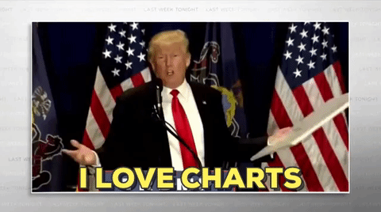

Analysis
Plotted a 3-axis map of UAL adjusted closing stock price, VADER mean compound score against the timeline
A time plot of the VADER mean score shows the hills and valleys of sentiments towards united airline.
The peaks represent positive sentiments while the valleys represent negative sentiments.
Drop in price and a sharp decrease in VADER Score
Price at peak but VADER Score is neutral

Slide 9
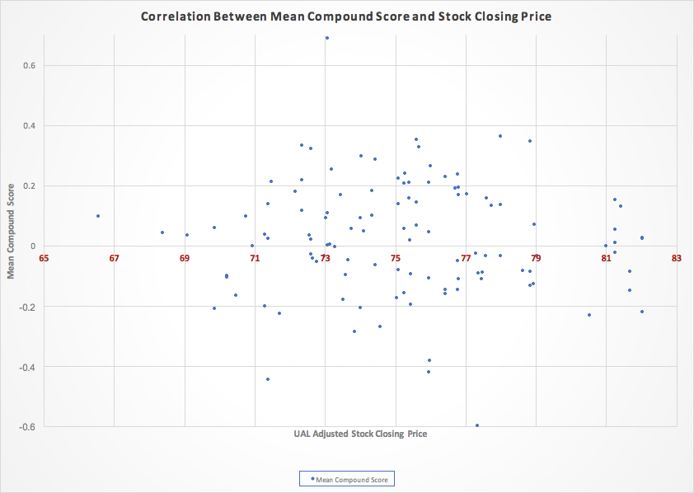
Empirical Analysis
The scatter plot shows there is very low/limited correlation between United Airline Stock Prices and Vader Sentiment Mean Score.
This finding sharply contrasts with the time plot that shows that both series captured each other’s movements overall.
Notes:
A scatter / Time plot of the two variables show no correlation. It’s still good practice to perform a correlation test to back up this claim empirically.
This finding sharply contrasts with the time plot that shows that both series captured each other’s movements overall.
This finding sharply contrasts with the time plot that shows some dependency between the two time series overall.

Slide 10


Computing Correlation Coefficient
The correlation coefficient was calculated using this formula:
Where r = correlation coefficient
X = UAL (United Airline Stock Prices)
Y = Vader Sentiment Mean Score
n = 115 (degrees of freedom)
The correlation coefficient (r) is -0.058, which is not big enough to derive statistical conclusion. Hence, we conclude that there is no linear dependence between the variables.
Notes:
This reinforces our earlier claim that there is no visible correlation between United Airline Stock Price and Twitter Sentiments.
r = (n*(SUM(X,Y) - (SUM(X) * (SUM(Y))) / SQRT((n*SUM(X^2) - SUM(X)^2)*(n*SUM(Y^2) - SUM(Y)^2))

Slide 11


Findings
This is in line with other studies: for instance, Gabriele Ranco et al. (2015) found a relatively low correlation and causality between Twitter Sentiments and 30 stock companies that form the Dow Jones Industrial Average (DJIA) index.
The estimates from the correlation coefficient estimation indicates there is no correlation between United Airline Stock Price and Twitter Sentiment Scores.
This finding reinforces the earlier claim that there is no visual relationship following the scatter graph of the two variables.
Notes:
Source: Ranco G, Aleksovski D, Caldarelli G, Grčar M, Mozetič I (2015) The Effects of Twitter Sentiment on Stock Price Returns. PLoS ONE 10(9): e0138441. https://doi.org/10.1371/journal.pone.0138441

Slide 12
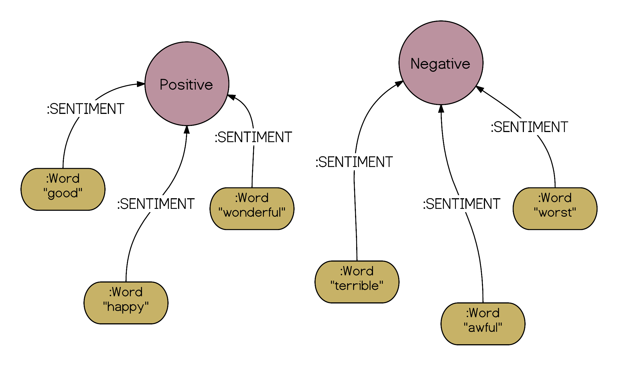

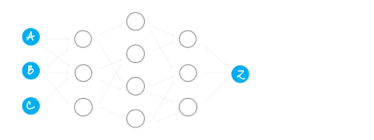
Future Research
Naïve Bayes Lemma
It would be really interesting to investigate the causal relationship between these two random variables using Granger Causality.
This is because the time plot of the two variables show periods of overlap between the relationships; hence, it’ll be of importance to determine the direction of causality between the variables.
WEKA library for Machine Learning
Clustering
Unsupervised model to discover words association
Notes:
Cluster - Clustering models focus on identifying groups of similar records and labeling the records according to the group to which they belong.
Bayes - Naive Bayes Classifier is based on the bag-of-words model.
With the bag-of-words model we check which word of the text-document appears in a positive-words-list or a negative-words-list. If the word appears in a positive-words-list the total score of the text is updated with +1 and vice versa. If at the end the total score is positive, the text is classified as positive and if it is negative, the text is classified as negative. Simple enough!

Slide 13
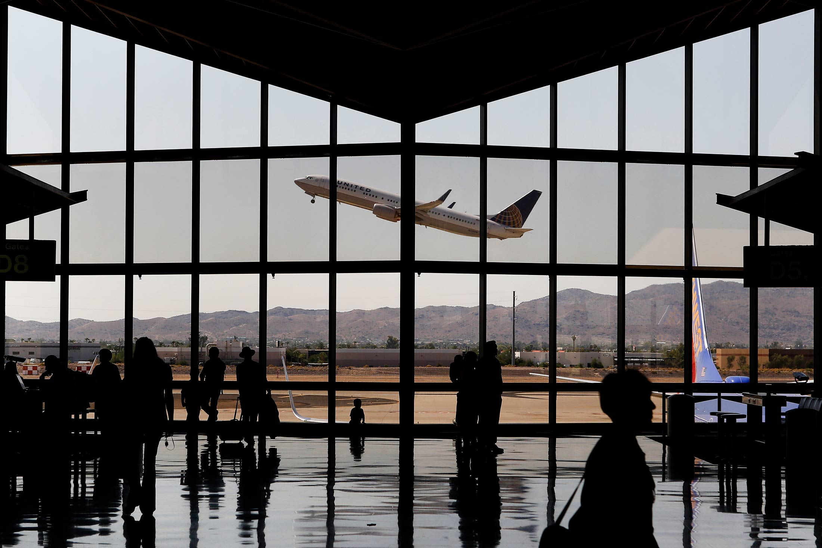
Q&A’s

Slide 14

Appendix
Google Repository
Clustering model
Bayes Classifier
Sentiment Analysis
Naive Bayes and Text Classification
Bayes Classifier
Beautifulsoup Documentation

Slide 15
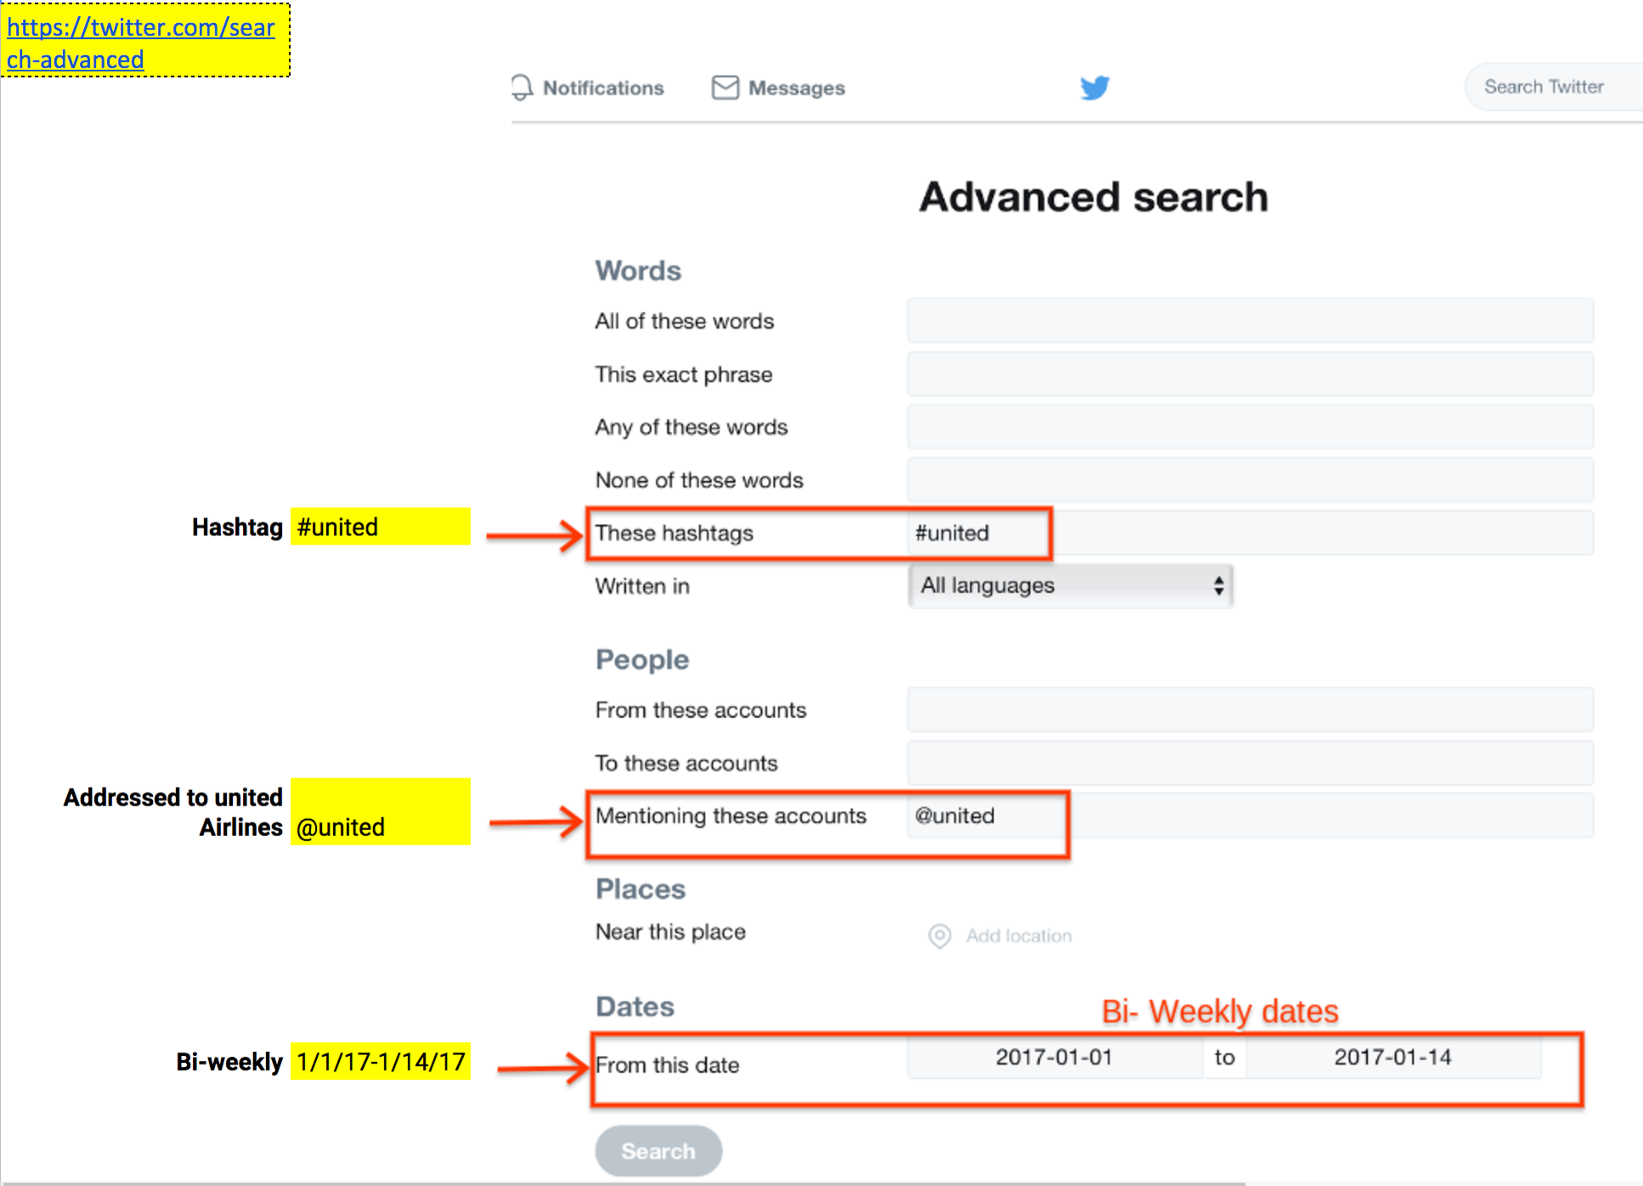
Twitter Advanced Search Guidelines

Slide 16
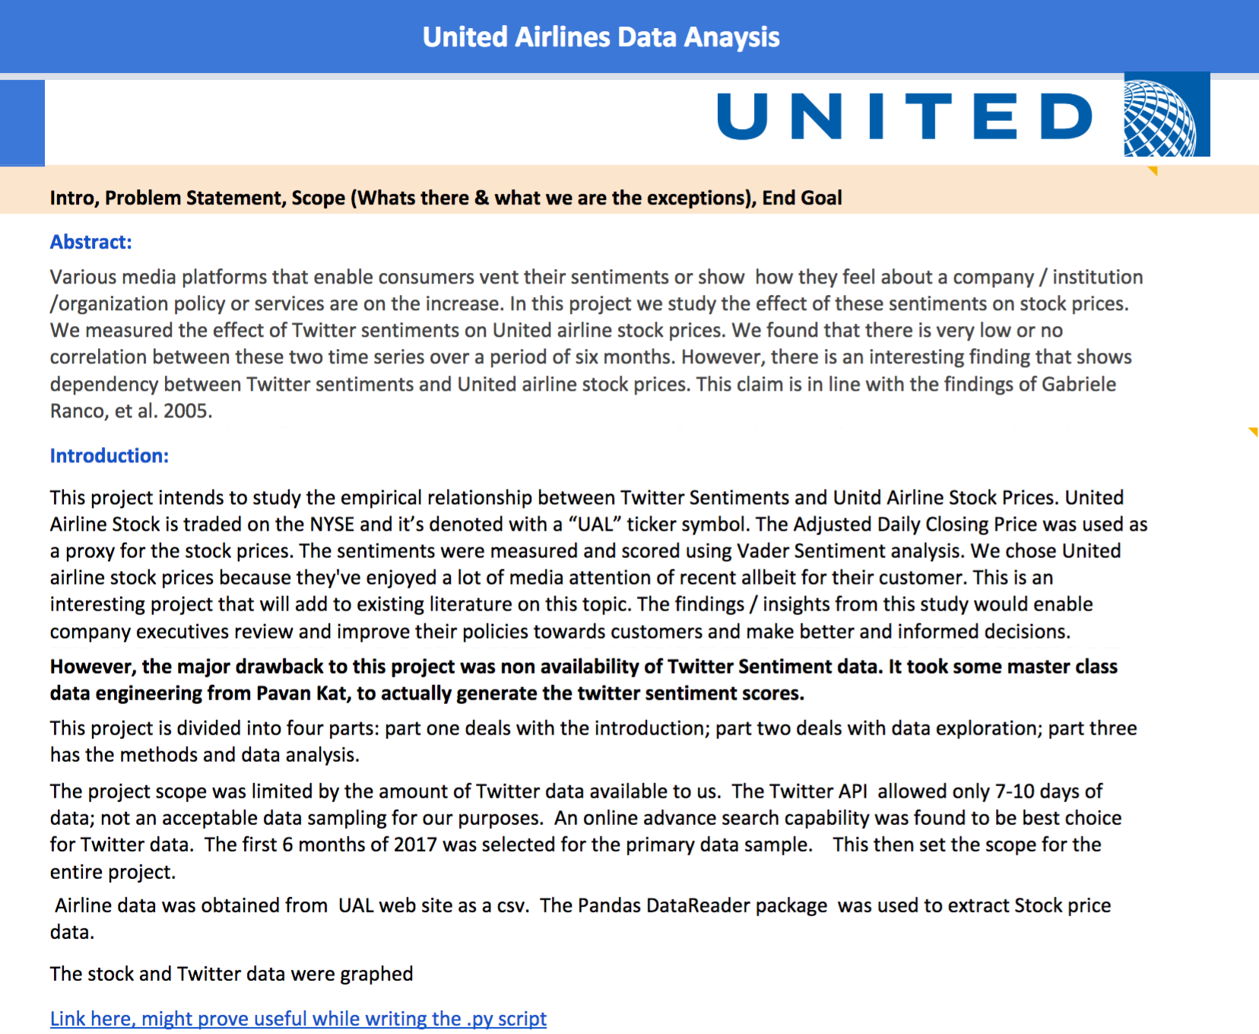
Report Summary
Click on the link below to read the whole report
Read More

Slide 17
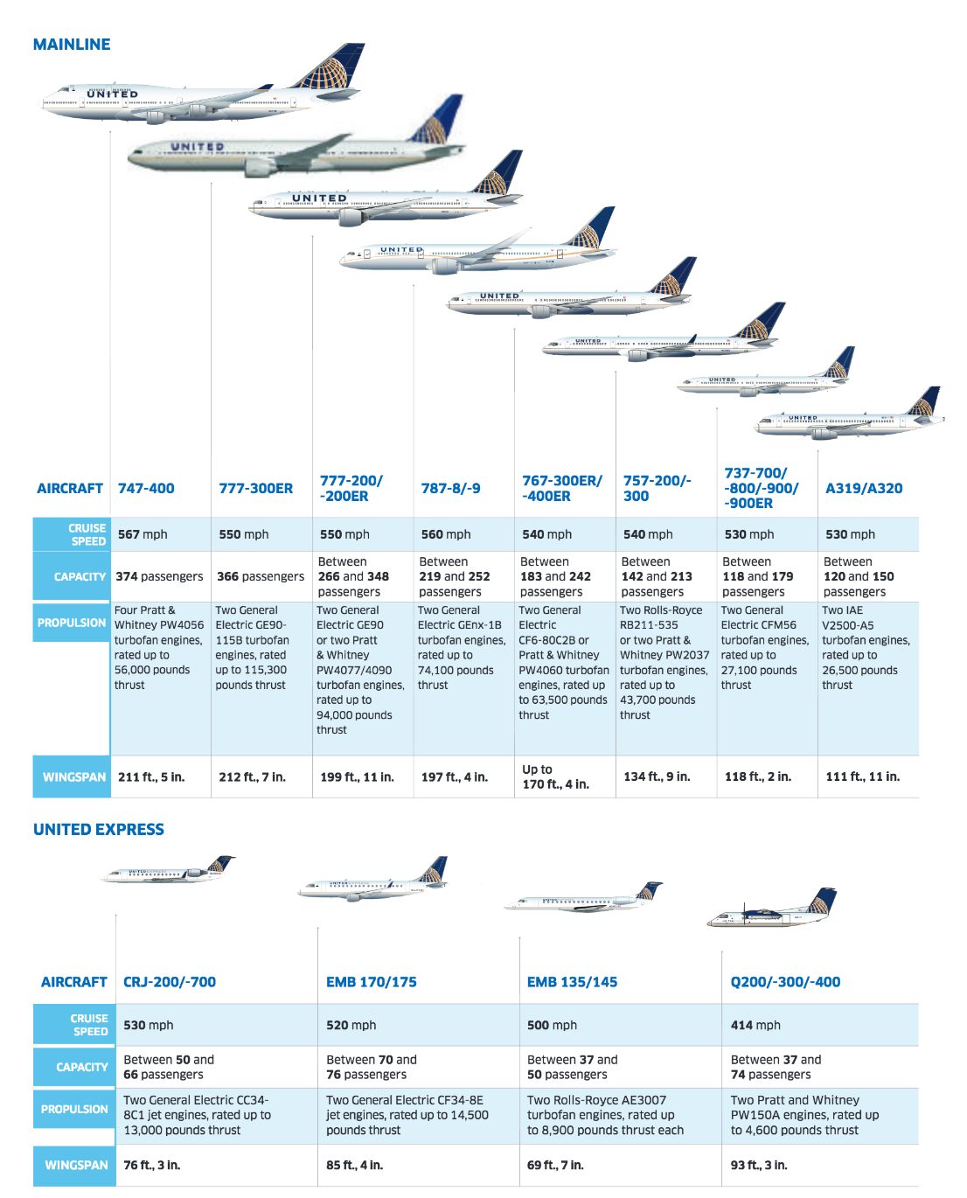
United Fleet Details
Fleet details as published and featured in Hemispheres, United's inflight magazine, featuring the latest business and travel trends.
Read More
Notes:
Source: https://www.united.com/web/en-US/content/travel/inflight/entertainment/reading/

